Slide 1

Collections

Slide 2
Agenda
In this session, you will learn about:
Goals of Collection
Collection Interfaces
List
Iterator
Map

Slide 3
Collections
Goals of Collections
The Collections Framework was designed to meet several goals.
The framework had to be high-performance. The implementations for the fundamental collections (dynamic arrays, linked lists, trees, and hash tables) are highly efficient
The framework had to allow different types of collections to work in a similar manner and with a high degree of interoperability.
Extending and/or adapting a collection had to be easy.

Slide 4
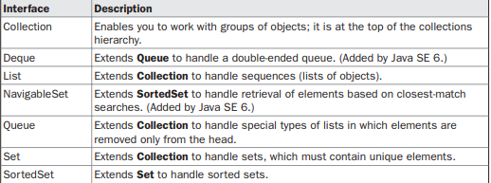
Collections
The Collections Interfaces
The Collections Framework defines several interfaces. The interfaces that underpin collections are summarized in the following table:

Slide 5
Collections
The Collections Interfaces
The Collection Interface The Collection interface is the foundation upon which the Collections Framework is built because it must be implemented by any class that defines a collection.
Collection is a generic interface that has this declaration:
interface Collection<E>
Here, E specifies the type of objects that the collection will hold. Collection extends the Iterable interface.
This means that all collections can be cycled through by use of the for-each style forloop.

Slide 6
Collections
The Collections Interfaces
Some of the classes provide full implementations that can be used as-is.
Others are abstract, providing skeletal implementations that are used as starting points for creating concrete collections.
None of the collection classes are synchronized and it is also possible to obtain synchronized versions.

Slide 7
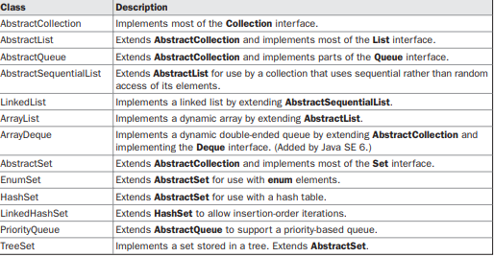
Collections
The Collections Classes

Slide 8
Collections
Accessing Collection via an Iterator
The elements in a collection can be cycled and be displayed by employing an Iterator.
Iterator is an object that implements either the Iterator or the ListIterator interface.
Iterator enables you to cycle through a collection, obtaining or removing elements.
ListIterator extends Iterator to allow bidirectional traversal of a list, and the modification of elements. Iterator and ListIterator are generic interfaces which are declared as shown here:
interface Iterator<E>
interface ListIterator<E>

Slide 9
Collections
Using Iterator
To access a collection through an iterator, an iterator should be obtained.
Each of the collection classes provides an iterator( ) method that returns an iterator to the start of the collection.
By using this iterator object, each element in the collection can be accessed, one element at a time.
In general, to use an iterator to cycle through the contents of a collection, following are the steps:
1. Obtain an iterator to the start of the collection by calling the collection’s iterator( ) method.
2. Set up a loop that makes a call to hasNext( ). Have the loop iterate as long as hasNext( ) returns true.
3. Within the loop, obtain each element by calling next( ).

Slide 10
Collections
Using Iterator
To access a collection through an iterator, an iterator should be obtained.
Each of the collection classes provides an iterator( ) method that returns an iterator to the start of the collection.
By using this iterator object, each element in the collection can be accessed, one element at a time.

Slide 11
Collections
Using Iterator - Demonstration
package com.imarticus.tutorial.arraystringcollectiongenerics.demos.collections;
// Demonstrate iterators.
import java.util.*;
public class BookIterator {
public static void main(String args[]) {
// Create an array list.
ArrayList<String> bookList = new ArrayList<String>();
// Add elements to the array list.
bookList.add("Complete References of Java");
bookList.add("Annie Marie");
bookList.add("Eagles of the seatown");
Notes:
C:\Users\vivinaya\Desktop\Muthu\course-content-preparation\semester2\1-java8\2-arrays-strings-collections-generics\2-class-exercises-and-demos\arrays-strings-collections-generics\src\com\imarticus\tutorial\arraystringcollectiongenerics\demos\collections\BookIterator.java

Slide 12
Collections
Using Iterator - Demonstration
// Use iterator to display contents of bookList.
System.out.print("Original contents of al: ");
Iterator<String> itr = bookList.iterator();
while (itr.hasNext()) {
String book = itr.next();
System.out.print(book + ", ");
}
System.out.println();
// Modify objects being iterated.
ListIterator<String> litr = bookList.listIterator();
while (litr.hasNext()) {
String book = litr.next();
litr.set(book + ";");
}
Notes:
C:\Users\vivinaya\Desktop\Muthu\course-content-preparation\semester2\1-java8\2-arrays-strings-collections-generics\2-class-exercises-and-demos\arrays-strings-collections-generics\src\com\imarticus\tutorial\arraystringcollectiongenerics\demos\collections\BookIterator.java

Slide 13
Collections
Using Iterator - Demonstration
System.out.print("Modified contents of al: ");
itr = bookList.iterator();
while (itr.hasNext()) {
String book = itr.next();
System.out.print(book + " ");
}
System.out.println();
// Now, display the list backwards.
System.out.print("Modified list backwards: ");
while (litr.hasPrevious()) {
String book = litr.previous();
System.out.print(book + " ");
}
System.out.println();
}
}
Notes:
C:\Users\vivinaya\Desktop\Muthu\course-content-preparation\semester2\1-java8\2-arrays-strings-collections-generics\2-class-exercises-and-demos\arrays-strings-collections-generics\src\com\imarticus\tutorial\arraystringcollectiongenerics\demos\collections\BookIterator.java

Slide 14
Collections
Storing user defined classes in collections
Collections are not limited to the storage of built-in objects. Quite the contrary.
The power of collections is that they can store any type of object, including objects of classes that are created.
For example, consider the following example that uses a LinkedList to store mailing addresses:

Slide 15
Collections
Storing user defined classes in collections
// A simple mailing list example.
import java.util.*;
class Customer {
private String name;
private String street;
private String city;
private String state;
private String code;
}
Notes:
C:\Users\vivinaya\Desktop\Muthu\course-content-preparation\semester2\1-java8\2-arrays-strings-collections-generics\2-class-exercises-and-demos\arrays-strings-collections-generics\src\com\imarticus\tutorial\arraystringcollectiongenerics\demos\collections\MailList.java

Slide 16
Collections
Storing user defined classes in collections
public class MailList {
public static void main(String args[]) {
LinkedList<Customer> customers = new LinkedList<Customer>();
// Add elements to the linked list.
customers.add(new Customer("J.W. West", "11 Oak Ave", "Urbana", "IL", "61801"));
customers.add(new Customer("Ralph Baker", "1142 Maple Lane", "Mahomet", "IL", "61853"));
customers.add(new Customer("Tom Carlton", "867 Elm St", "Champaign", "IL", "61820"));
// Display the mailing list.
for (Customer customer : customers)
System.out.println(customer);
}
}
Notes:
C:\Users\vivinaya\Desktop\Muthu\course-content-preparation\semester2\1-java8\2-arrays-strings-collections-generics\2-class-exercises-and-demos\arrays-strings-collections-generics\src\com\imarticus\tutorial\arraystringcollectiongenerics\demos\collections\MailList.java

Slide 17
Collections
Working with Maps
Map: an unordered collection that associates a collection of element values with a set of keys so that elements they can be found very quickly
Each key can appear at most once (no duplicate keys)
A key maps to at most one value
The main operations:
put(key, value) "Map this key to that value."
get(key) "What value, if any, does this key map to?“
Maps are also called:
hashes or hash tables
dictionaries
associative arrays

Slide 18
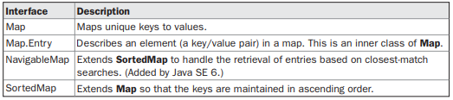
Collections
Working with Maps – The Map Interfaces

Slide 19
Collections
Map – Definition
public interface Map { Object put(Object key, Object value); Object get(Object key); Object remove(Object key); boolean containsKey(Object key); boolean containsValue(Object value); int size(); boolean isEmpty(); void putAll(Map map); void clear(); Set keySet(); Collection values();
}
Basic ops
Bulk ops
Collection
views
19

Slide 20
Collections
Find Rack Name by Book
//Book Name and Rack Number location
Map<String,Integer> bookLocations = new HashMap<>();
bookLocations.put("The God of Small Things", 2);
bookLocations.put("Alchemist",1);
bookLocations.put("The Great Gastby",1);
System.out.println(
"The Great GatsBy is in Rack number " + bookLocations.get("The Great Gastby"));
Notes:
semester2\1-java8\2-arrays-strings-collections-generics\2-class-exercises-and-demos\arrays-strings-collections-generics\src\com\imarticus\tutorial\arraystringcollectiongenerics\demos\generics\FindBookRack.java

Slide 21

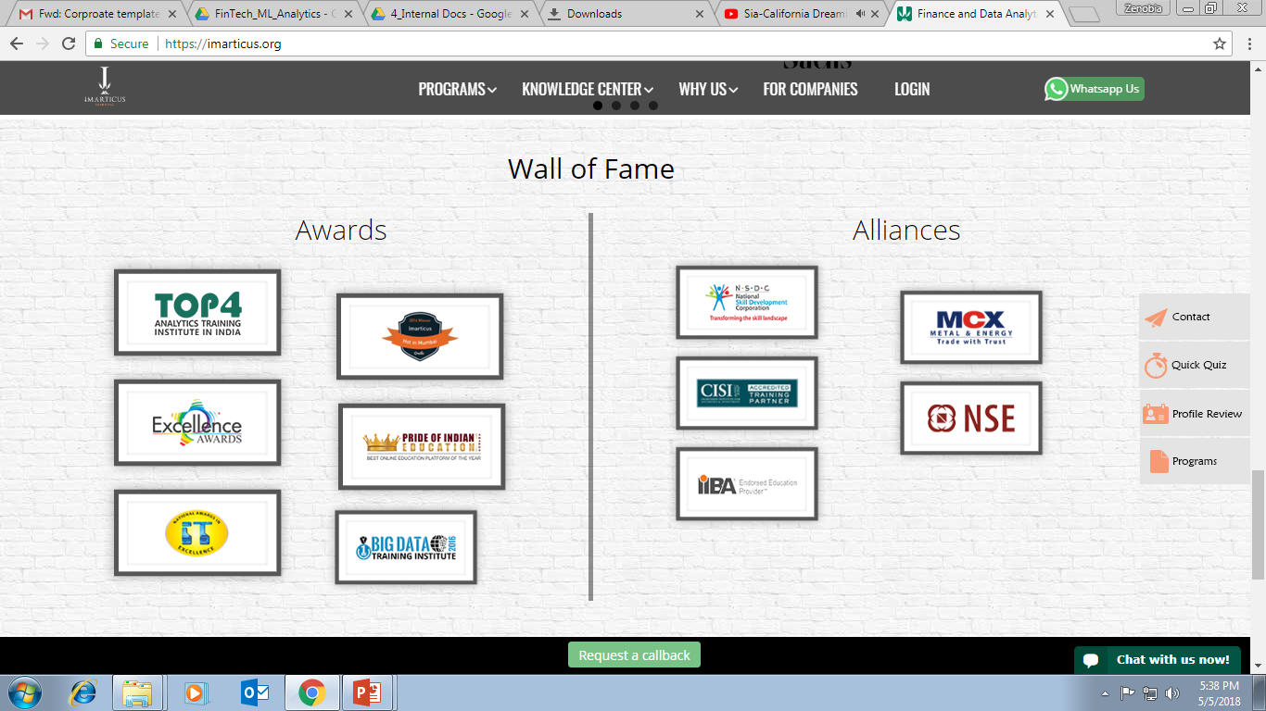



AWARDS:
Learn more:
https://imarticus.org/corporate/
Email us:
info@imarticus.com
Connect with us:
www.linkedin.com/company/imarticuslearning
ACCREDITED TRAINING PARTNER:
Watch us:
www.youtube.com/ImarticusLearninginstitute
Visit us:
Mumbai | Thane | Pune | Bangalore | Delhi - NCR | Hyderabad | Chennai | Coimbatore

